Slide 1


Slide 2


Slide 3
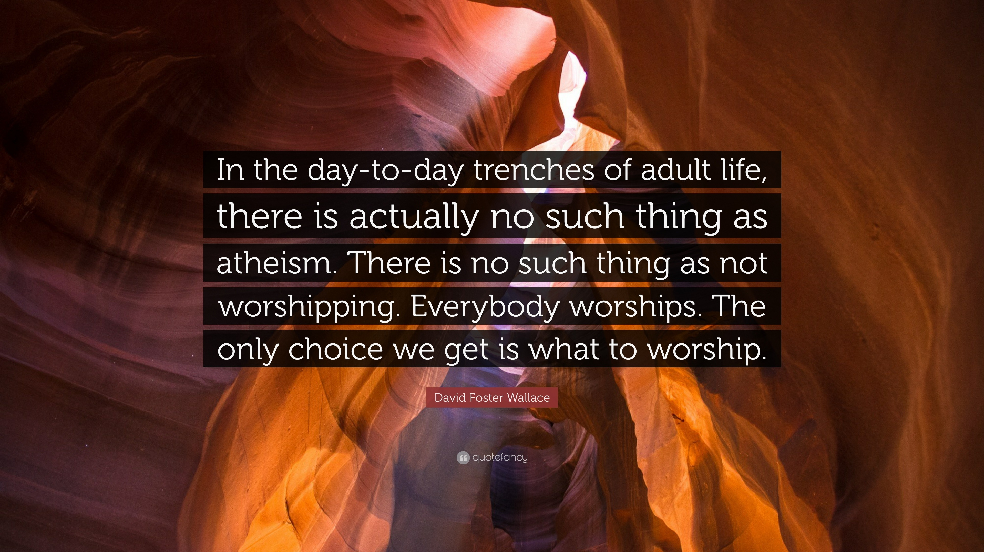

Slide 5


Slide 6
FAKE WORSHIP IS…
Created

Slide 7
FAKE WORSHIP IS…
Created
Cued

Slide 8
FAKE WORSHIP IS…
Created
Cued
Conformed

Slide 9
FAKE WORSHIP IS…
Created
Cued
Conformed
Coerced

Slide 10
FAKE WORSHIP IS…
Created
Cued
Conformed
Coerced
Comical

Slide 11


Slide 12
WE WILL NOT

Slide 13
WE WILL NOT
BUT EVEN IF HE DOES NOT

Slide 14
WE WILL NOT
BUT EVEN IF HE DOES NOT
You need to know that what you worship is as committed to you as you are to it
HOW?!

